Slide 1
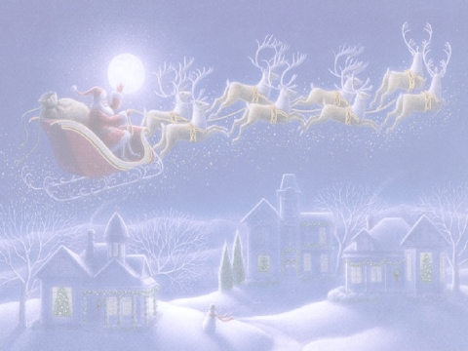


Epsilon Sigma Alpha and Santa-America
Santa HUGs for Special Children

Slide 2
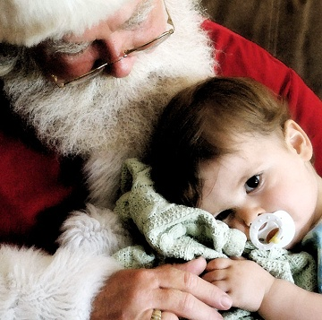
  “Visit www.SantaAmerica.org”
Notes:
Santa-America galvanizes community
Involves medical community, educators, students, social services, local government, social workers, area businesses and service clubs in a long-term.
Enhancing pediatric grief and bereavement long after hospice care.
The gift you give brings LOVE, HOPE and JOY to our Special Children and Our Community…and you, personally and Collectively, will feel the Magic of Santa and His Elves.

Slide 3
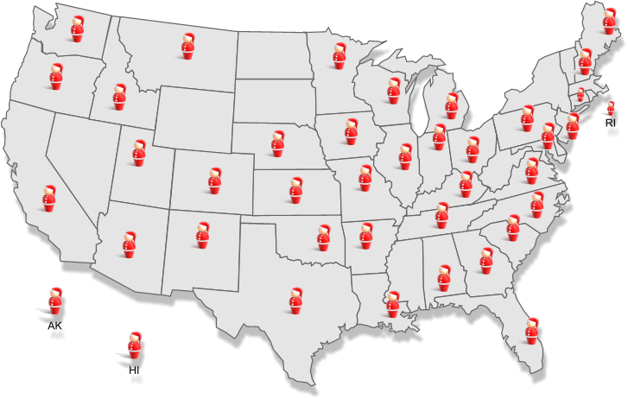
Who is Santa-America?
200+ Santas, Mrs. Clauses & Elves (ages 10 to 87!!) who are…….
Backgrounded
TB Tested
Trained in…
Hospice care
Bereavement
Pediatric Hospital
HIPPA
Guess where the Real North Pole is???
YOUR COMMUNITY!!
Notes:
Southwest Alabama is the North Pole

Slide 4
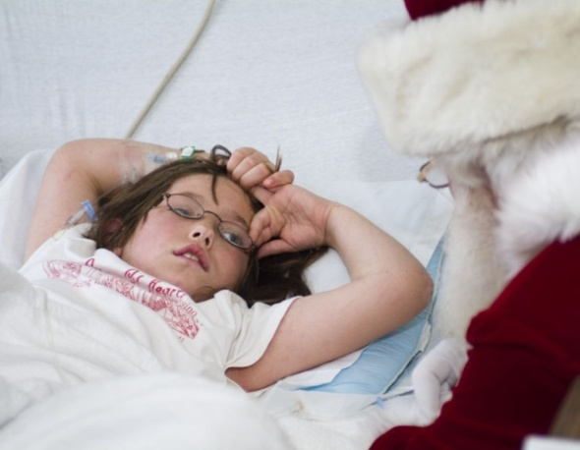
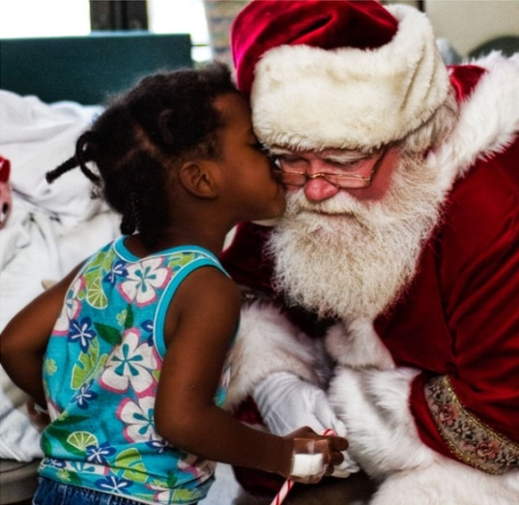
Who Does Santa America Visit?
Children & families in crisis and coping with…
  Hospice Care
    Child, Parent, Grandparent
  Chronic Pediatric Illness
    Cancer
    Down Syndrome
    MS
    Cystic Fibrosis
    Autism - Spectrum Disorders
Post Traumatic Stress
    Abuse
    Natural Disaster
    Loss of family member on active duty
Notes:
Ages of Children : we’ve seen children as young as 3 weeks - adults

Slide 5
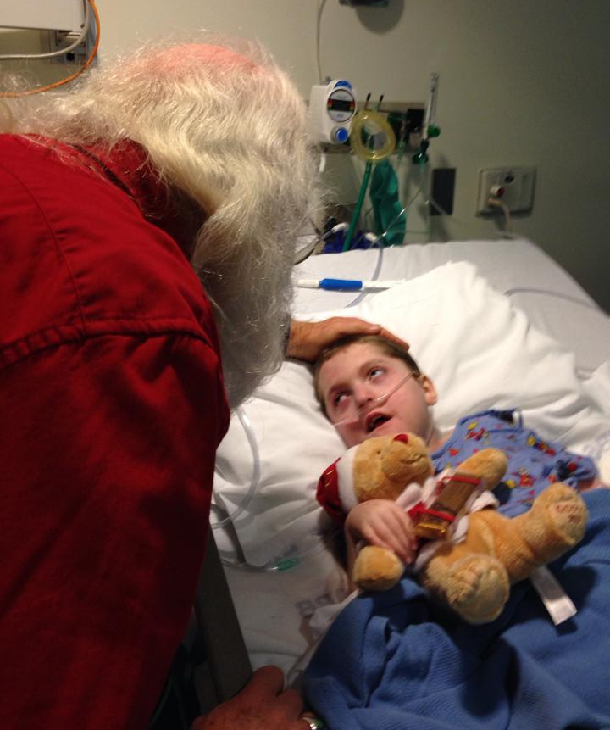
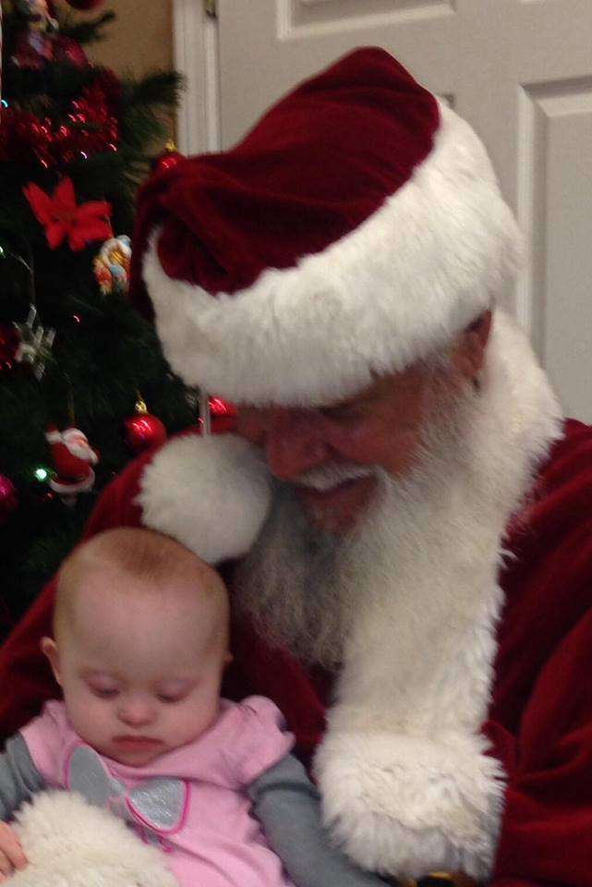
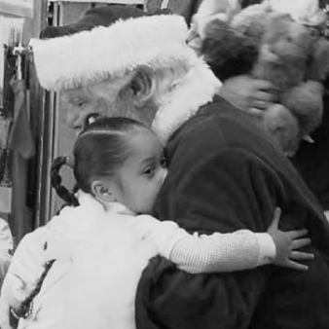
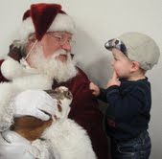
With Santa America...
It’s More than a Visit!
Our Children and Families have a “Special Relationship” with Santa, sometimes for10 years or more… (really, it’s forever!)

Slide 6
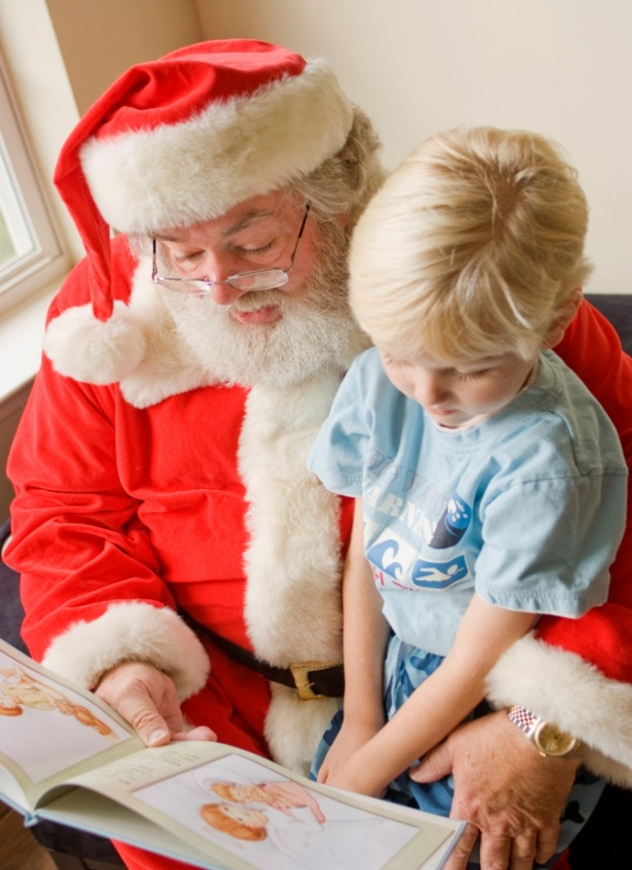
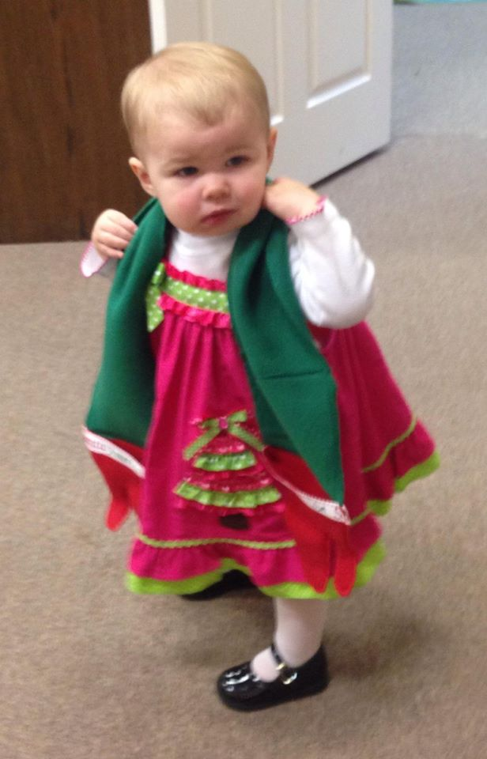

Santa America Gifts
Our “Gifts” keep the focus of Santa’s visit on the child and the values of Love, Hope and Joy!
Santa Hugs
Special Books
SUB’S!
All wrapped in Love! Hope! And Joy!
“An Angel In the Sky”
Notes:
We must be leaders, we can no longer give “toys” We are creating hand-made Santa Hugs and giving out “Sleigh Bells” (as funding allows)

Slide 7
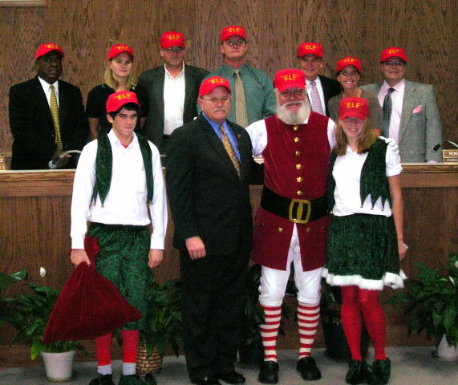
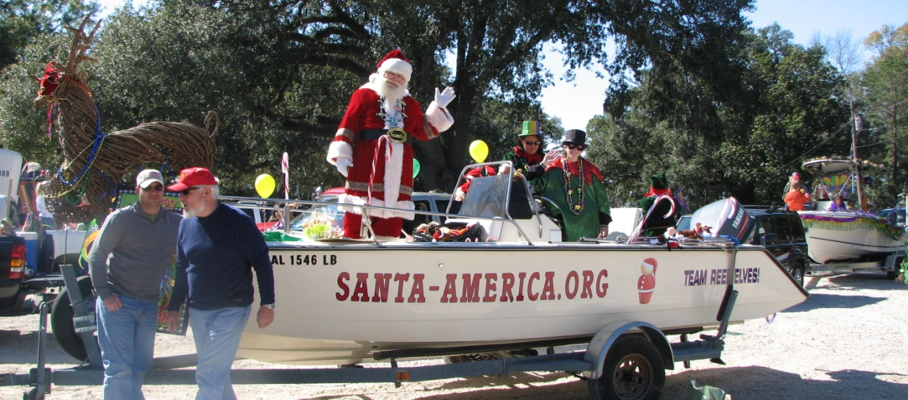
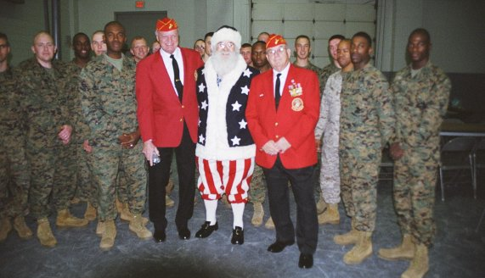
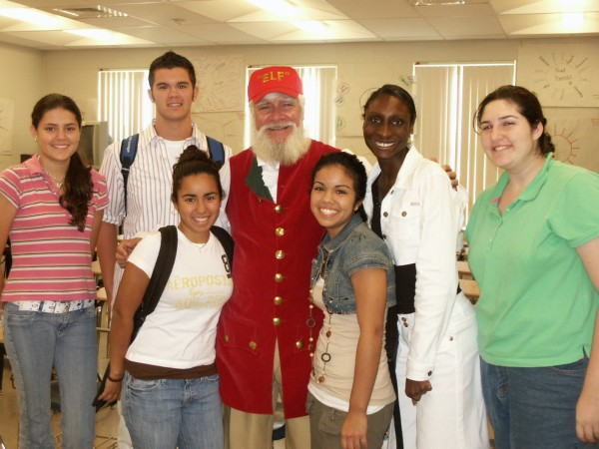
Santa America Builds
Community Spirit!
Notes:
We weave community. Who else but Santa can bring together folks from all generations, working together to provide a service to our children. Race, politics and faith are irrelevant but the gifts of Love, Hope and Joy are strong!
Our Medical Community is our referral base. We are beginning a pilot clinical trial with children with cystic fibrosis. We know spirituality helps adult heal and this trial will provide objective data on the benefits of Santa.
Our Special Elves: Students from across the county (student hospice and coordinated through schools) serve as supporters of Santa-America. Many students also accompany Santa on visits. We are also working with students from Springhill College to do media relations. Additionally, college recruiters place enormous value on this community service.

Slide 8
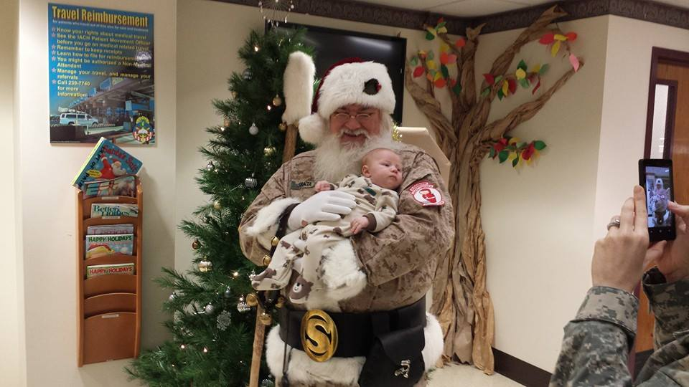
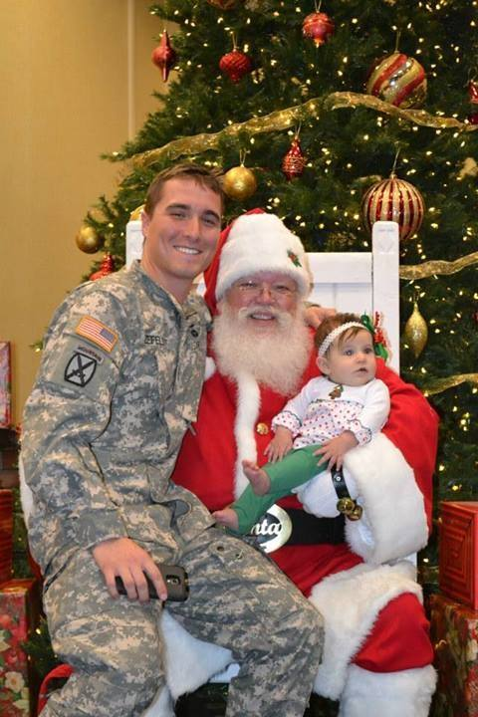
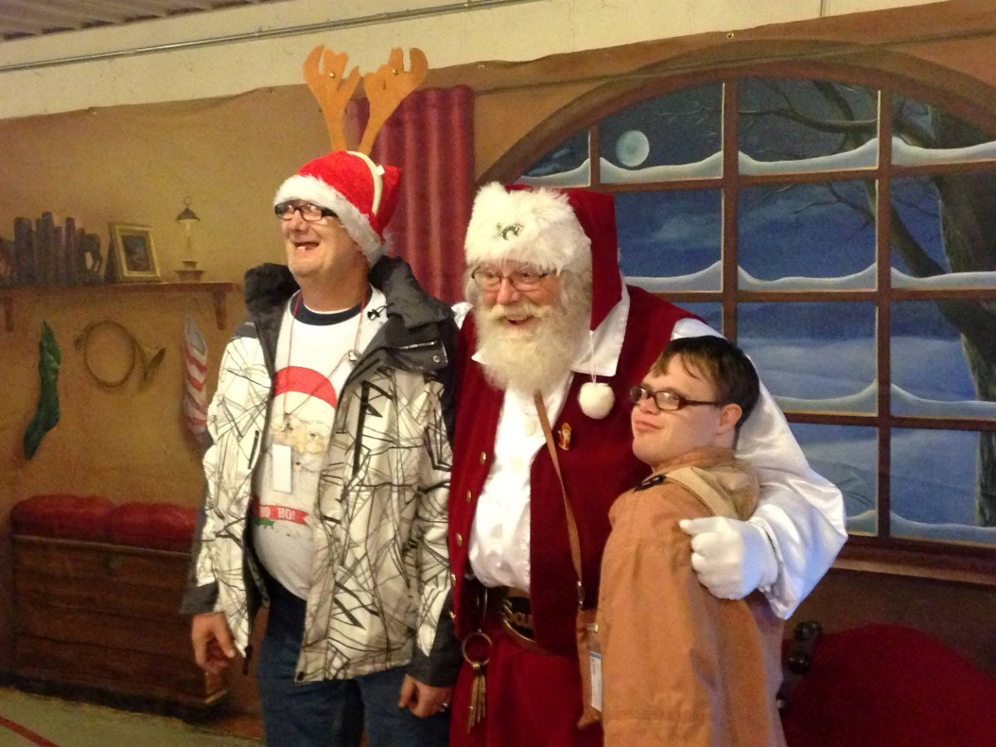
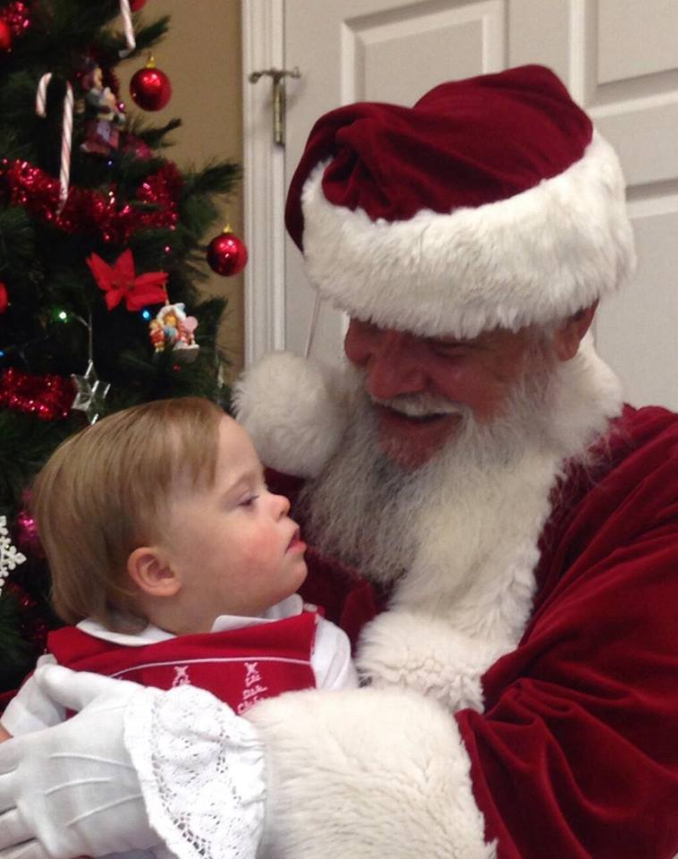

Slide 9
Santa America
Santa America brings Love, Hope and Joy......wrapped in a warm secure Santa hug.....to special needs children and their families 365days a year!

Slide 10
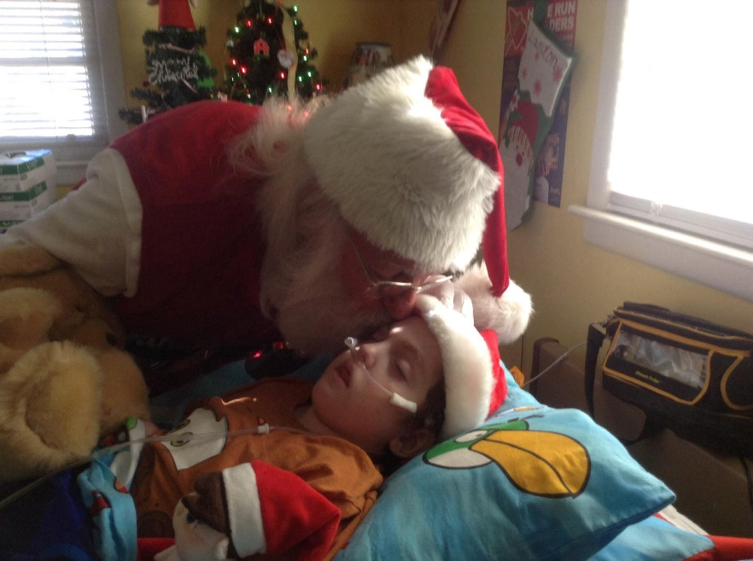
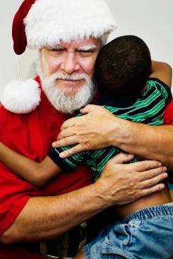

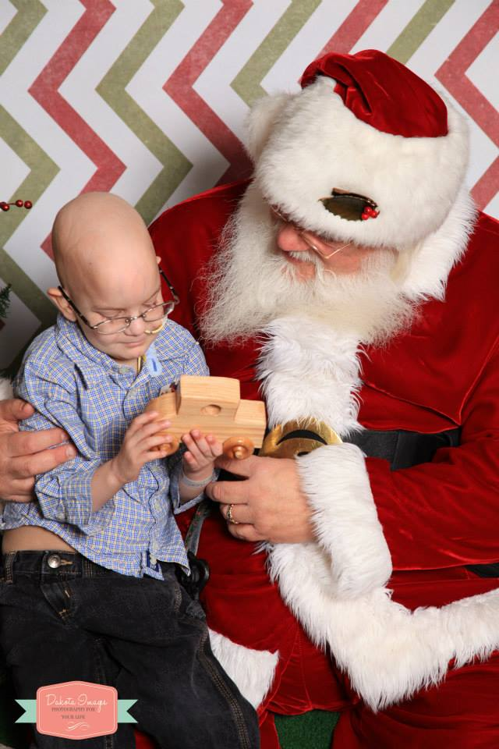
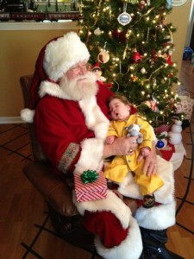

Slide 11
What is a HUG?
HUGs are special “handcrafted scarves with little mittens on the end
They are presented to children going through the toughest situations they can possibly face
  Children facing the end of life
  Children facing the end of life of a closed loved one
  Children dealing with Autism and other Spectrum Disorders
  Children and families of Wounded Warriors
  Children involved in natural disasters
They give a child something to hold on to and emotionally connect with for a positive experience

Slide 12
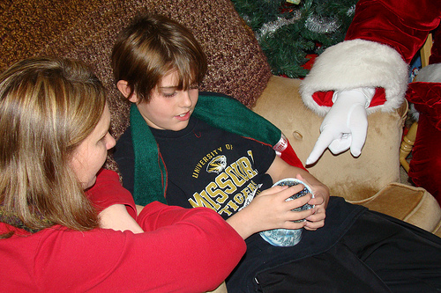
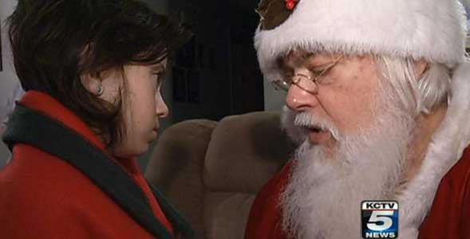

Slide 13
How many HUGs does Santa need?
We have been distributing HUGs since 2010, but we have been limited

Slide 14
How many HUGs does Santa need?
While we have been distributing HUGs, we were limited
Some children could not get HUGs because we did not have enough!

Slide 15
How many HUGs does Santa need?
While we have been distributing HUGs, we have been limited
Some children don’t get HUGs because we do not have enough
In 2013, Santa had to “choose” children to receive HUGs….very tough!

Slide 16
How many HUGs does Santa need?
While we have been distributing HUGs, we were limited
Some children don’t get HUGs because we do not have enough
Santa had to “choose” the children to receive HUGs
In order to fill 2014-2015 needs, Santa America requires………..

Slide 17
How many HUGs does Santa need?
While we have been distributing HUGs, we were limited
Some children don’t get HUGs because we did not have enough
Santa had to “choose” the children to receive HUGs
In order to fill the needs we have, we will require
8,000 HUGs
over the next 2 years!!

Slide 18

Epsilon Sigma Alpha to the rescue!!
Make HUGs in your chapters!
  Patterns, instructions…
  and labels…..available through ESA web-site
Send your completed HUGs to Santa-America in Daphne Alabama
  We will distribute to Santas all across America!
If you have meetings or events for special children, contact Santa-America…….We try to have Santa at your event!!
Together as Partners, Sigma Alpha Epsilon and Santa-America bring Love, Hope and Joy to children in tough circumstances

Slide 19
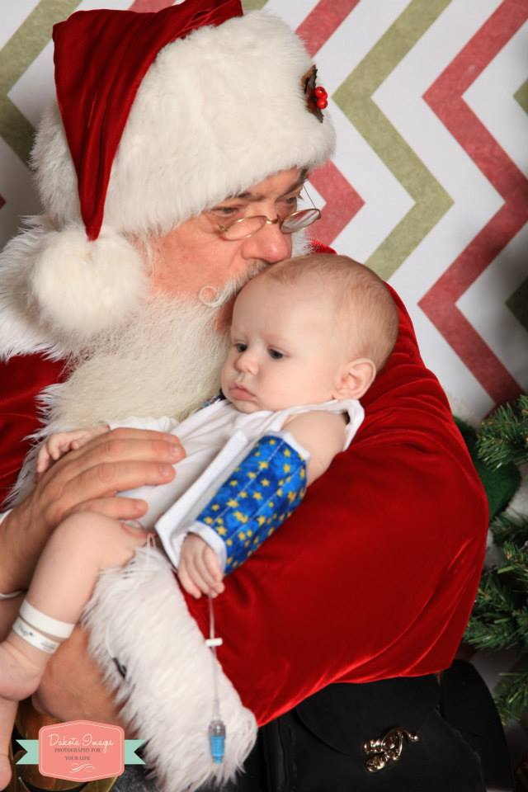
“Loving and caring for children is the rent we pay for living on this planet”

