Slide 1
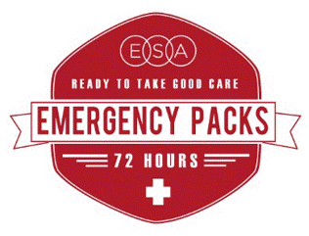
Free Community Info Event:
EASY WAYS TO KEEP YOUR FAMILY SAFE
IN AN EMERGENCY OR NATURAL DISASTER
Sponsored by Epsilon Sigma Alpha
In Partnership with <list first responders and community disaster partners helping at your event>
<When: date/time>
<Where: address/location>
<What: get resource lists, learn to make 72 hour emergency packs, see the firetruck etc>
<Who: Individuals, families, groups/organizations welcome>
STOP BY FOR 72 HOUR EMERGENCY PACKS GUIDES, RESOURCES LISTS, AND TIPS FROM FIRST RESPONDERS
For More Info:
<ADD E-MAIL AND PHONE #>
www.epsilonsigmaalpha.org

