Slide 1
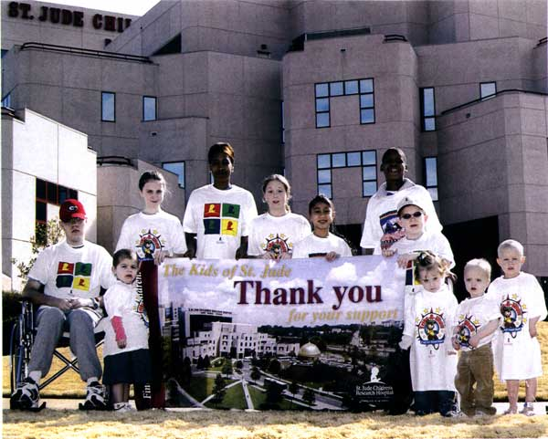

“No child should die in the dawn of life.” -- Danny Thomas
Notes:
About St. Jude Children’s Research Hospital: Since opening more than 50 years ago, St. Jude Children’s Research Hospital has changed the way the world treats childhood cancer and other life-threatening diseases. No family ever pays St. Jude for the care their child receives and, for every child treated at St. Jude, thousands more have been saved worldwide through St. Jude discoveries. The hospital has played a pivotal role in pushing U.S. pediatric cancer survival rates from 20 to 80 percent overall, and is the first and only National Cancer Institute-designated Comprehensive Cancer Center devoted to children. It is also a leader in the research and treatment of blood disorders and infectious diseases in children. St. Jude was founded by the late entertainer Danny Thomas, who believed that no child should die in the dawn of life.

Slide 2
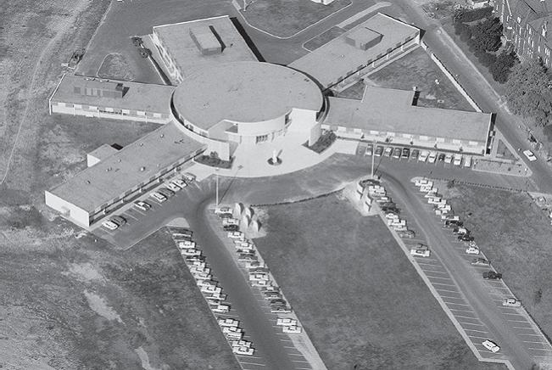
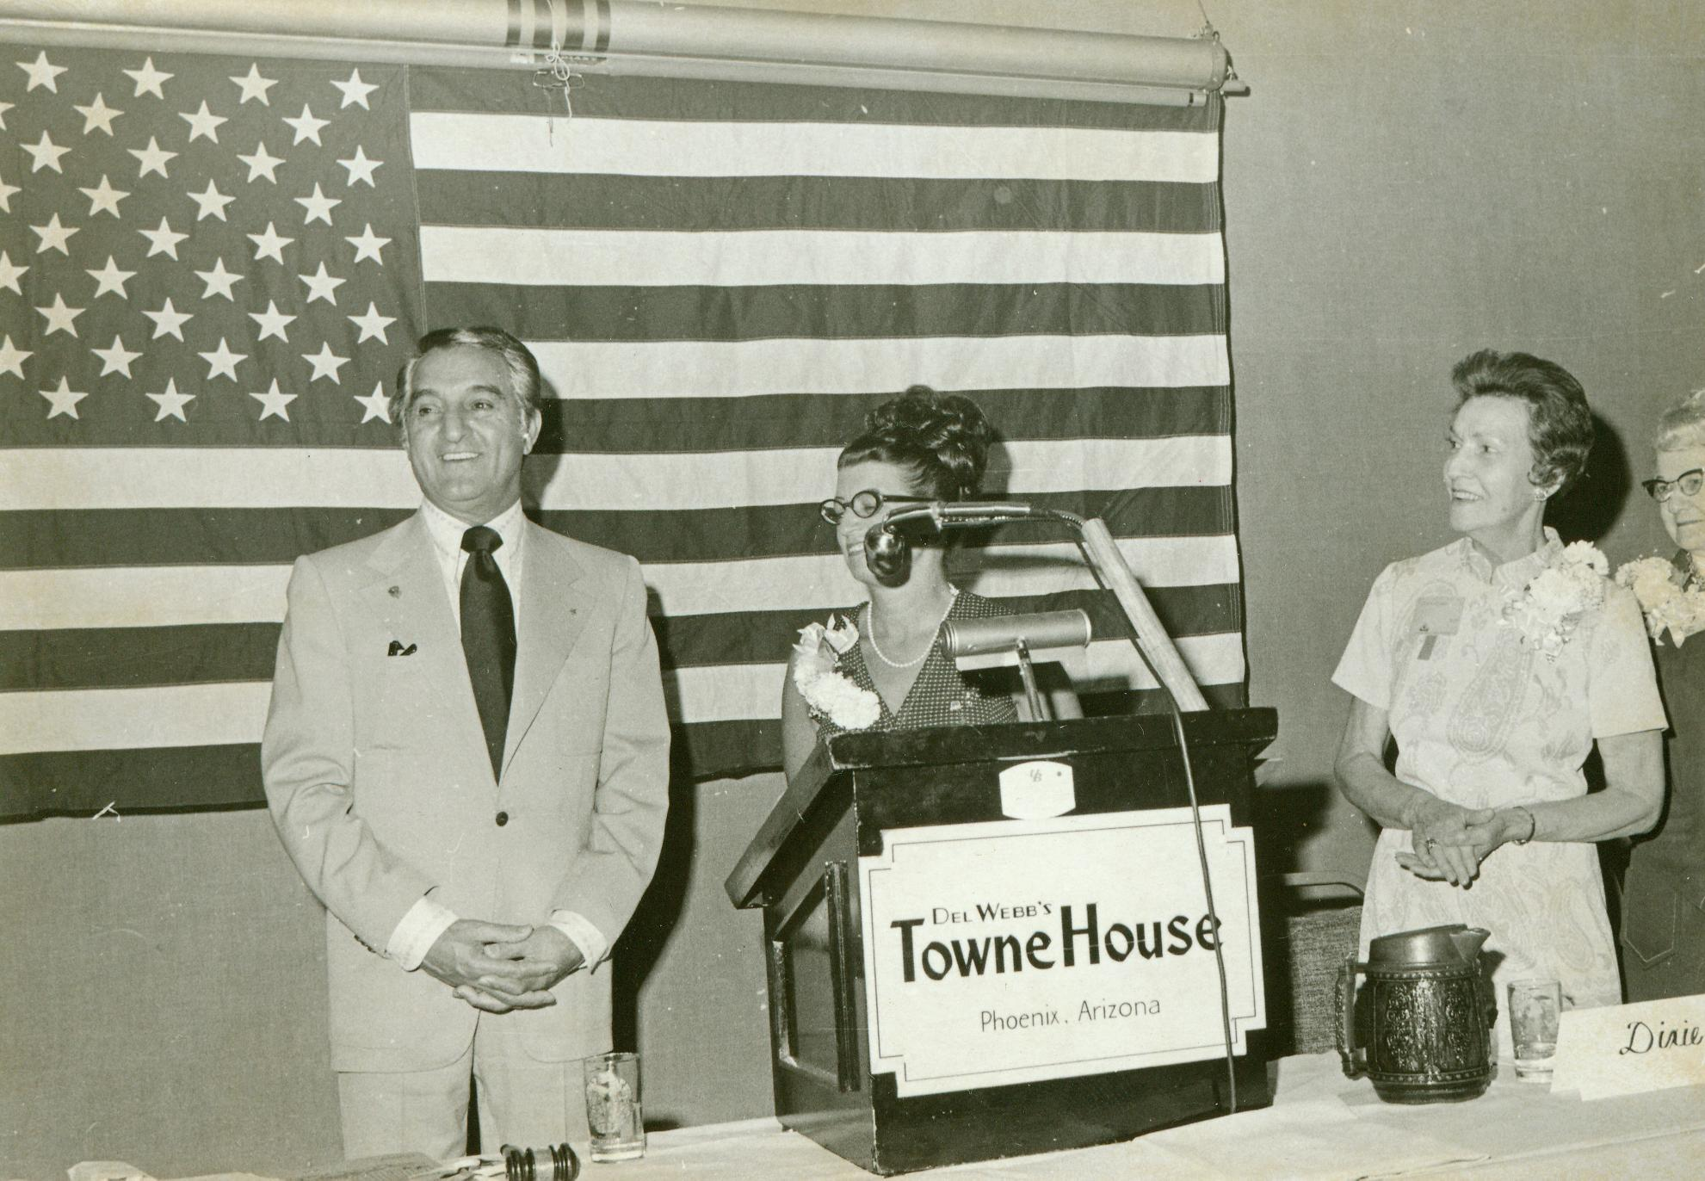
ESA FOR ST. JUDE: 40+ Years of Love
1972:
The survival rate for ALL leukemia was 50%
$16,164 needed to run St. Jude daily
ESA joins Danny Thomas and St. Jude and raises $200,000
Notes:
About ESA and St. Jude: Danny Thomas first approached ESA in 1972 requesting our help in supporting the hospital. Since that time, ESA has donated more than $200 million in cash and pledges and hundreds of thousands of volunteer hours to St. Jude. We staff major national events like Dreamhomes, radiothons and create hundreds of local events like this one to raise money and awareness for the St. Jude cause.
In 1972, when ESA began supporting the hospital, it took $16,164 dollars to run the hospital for one day, and the survival rate for acute lymphoblastic leukemia (ALL), the most common form of childhood cancer, was 50%, and that year ESA raised $200,000 for the hospital.

Slide 3
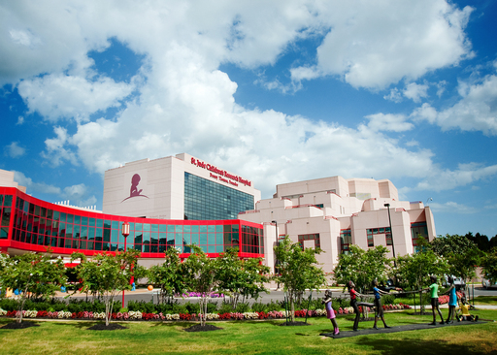
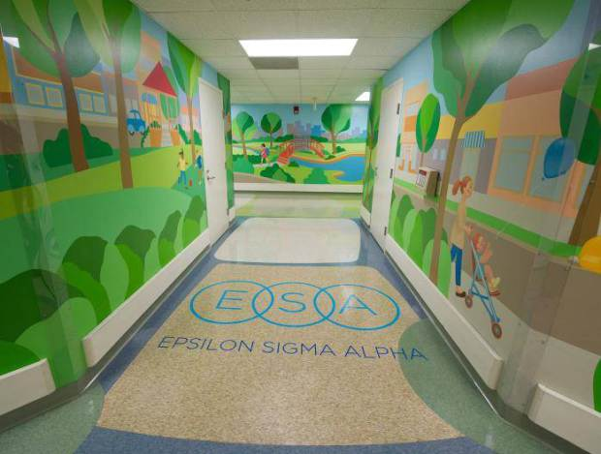
2014:
ALL survival rate 94%
$1.9 million needed daily
$175 million from ESA
Notes:
40+ years later, the survival rate for ALL is now 94%. It costs $1.9 million to operate the hospital every day . We are so proud to say ESA members now donate more than $10 million annually in cash and pledges to the hospital. In honor of our more than 40 years partnering with St. Jude, St. Jude recently dedicated named space in the Patient Care Pavilion to ESA.

Slide 4
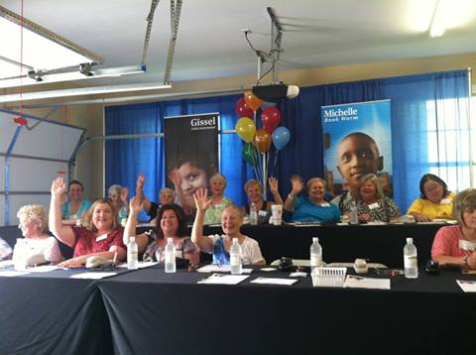
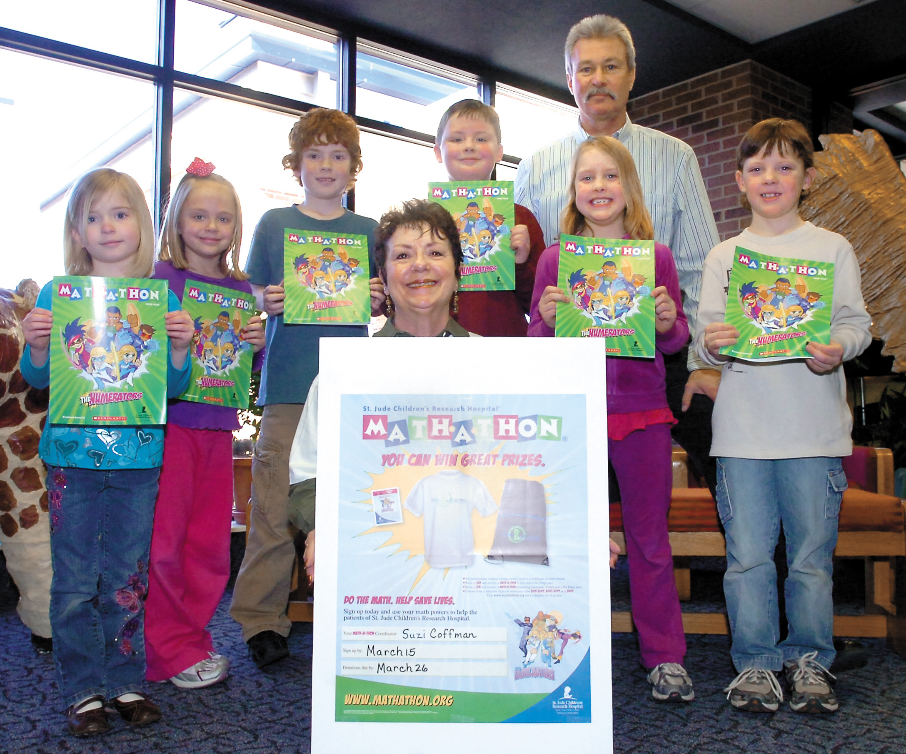
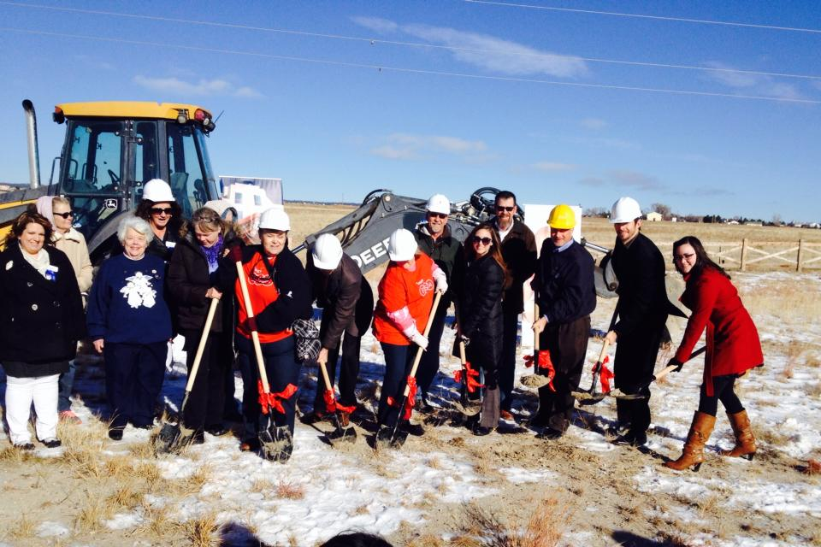

75% of St. Jude funding some from the public through events like
ESA’s today…
THANK YOU!
Notes:
More than 75 percent of that funding comes from the public through programs like our event today. We THANK YOU for helping St. Jude kids today.

Slide 5
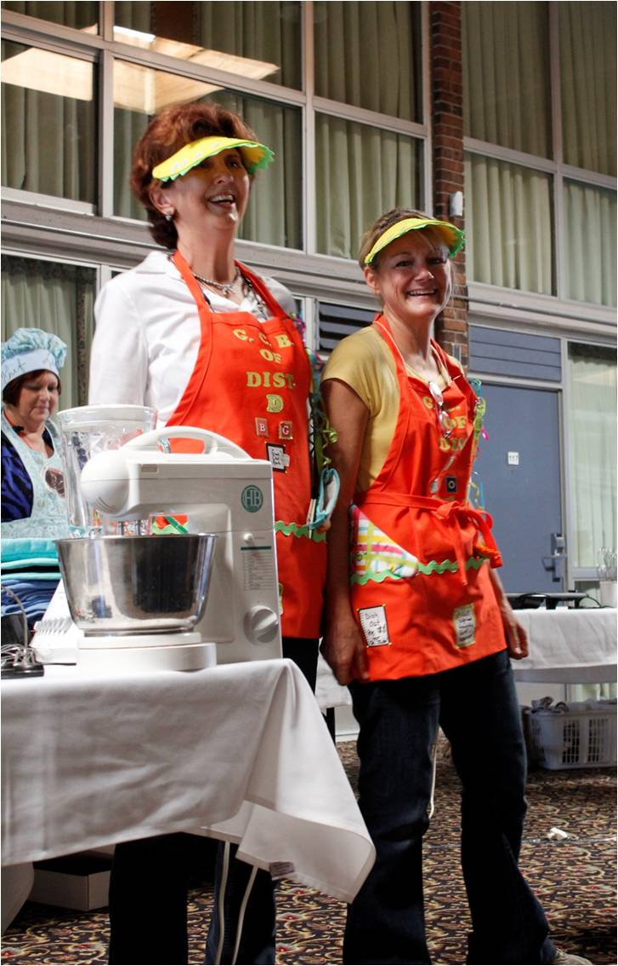

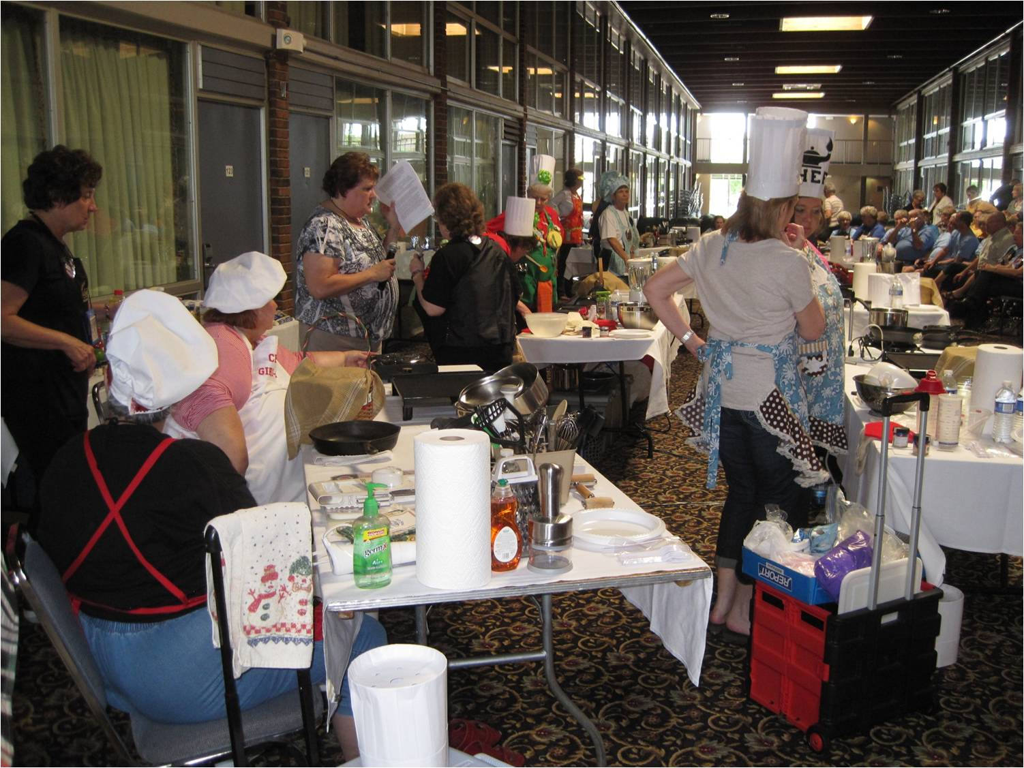
ESA’s Cookin’ for the Kids across the nation,
Way To Go
CITY NAME HERE!
Notes:
Insert your THANK YOU’s to your attendees, corporate sponsors, VIP’s, announce your total, other good news about today’s event success!

Slide 6
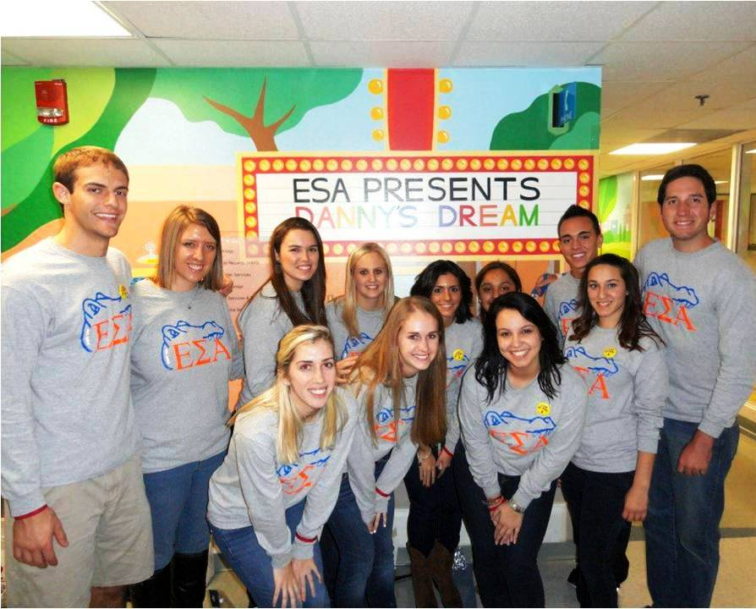
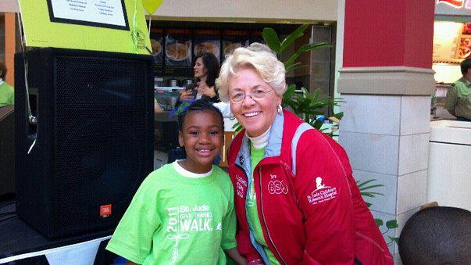
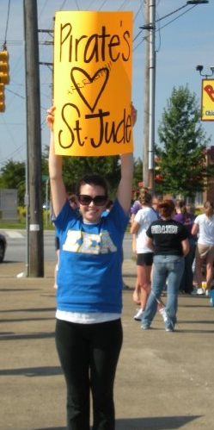
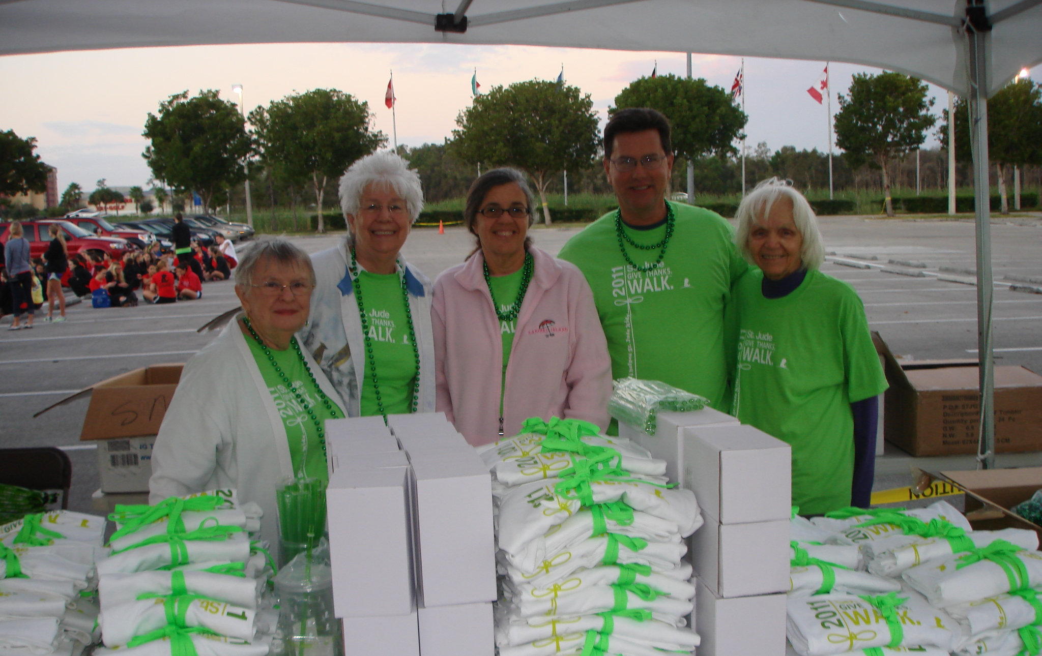
YOU are invited…
To our next ESA for St. Jude event
To join ESA
Ask an ESA member today
Notes:
You are invited! In ESA, we are ALL volunteers. We belong to Epsilon Sigma Alpha because we believe we have the power together to change the world, and because it’s FUN! ESA members volunteer more than 650,000 hours annually to help others. St. Jude Children’s Research Hospital is ESA’s largest international cause. We also support military members and veterans, Easter Seals Camp Hope, domestic violence and literacy causes, scholarships through our Foundation and scores of other local worthy causes. We are multi-national AND multi-generational, from college students to active seniors, and we are always keeping an eye out for others who might like to join ESA, spend time with good-hearted people, and make a difference with us. We’re so grateful you’re here today to help us support St. Jude and invite you to speak with one of the ESA members here today if you’d like to know more about joining ESA and helping with other great projects like this one. (tell them where in the room they can get more information)

