Slide 1
About St. Jude
Notes:
Thank you for being here and for your interest in St. Jude Children’s Research Hospital.
Today I am excited to share with you details about St. Jude and our Mission, as well as the benefits of partnering with St. Jude and aligning with our brand.

Slide 2
CANCER
is the
NUMBER ONE
cause of death
by disease in children under 14
in the United States
This year, the parents of nearly 16,000 children in the United States will hear the words:
“Your child has cancer.”
Notes:
This year, parents of nearly 16,000 children in the U.S. will hear these 4 words: YOUR CHILD HAS CANCER
In spite of the progress we have made in the past 50 years, one in five children diagnosed with cancer in the U.S. won’t survive and this is not acceptable. Our mission to find cures is urgent and we won’t stop until no child dies from cancer.
Transition:
Fortunately, there is hope for families that are faced with this devastating news. There is St. Jude Children’s Research Hospital.

Slide 3
“No child should die in the dawn of life.” - Danny Thomas, Founder
Notes:
Our founder, Danny Thomas, was an incredible visionary who believed that “no child should die in the dawn of life.”
Early in his career, as a struggling entertainer, he prayed to St. Jude Thaddeus, the patron saint of lost causes, “Help me find my way in life and I will build you a shrine.“ In the following years, Danny’s career flourished. But he never forgot that prayer or that promise. And he decided that the shrine he would build, would be St. Jude Children’s Research Hospital.
When he decided to start St. Jude, his idea was cutting edge -- a hospital where children could receive treatment for life-threatening diseases regardless of a family’s race, religion or financial status.
Danny rallied an army of people just like you and me to raise the funds and awareness needed to build and maintain St. Jude.
Which is what we are asking of you…

Slide 4
Treatments invented at St. Jude have helped push the overall childhood cancer survival rate from
20%
1962
to
80%
TODAY
^{We won’t stop until}
^{no child dies from cancer.}
Notes:
When St. Jude opened its doors in 1962, the overall survival rate for childhood cancer was just 20%. A diagnosis of cancer was considered by many to be “a death sentence.” In fact, our first medical director was deemed to be committing “career suicide” by his peers, focusing his efforts on such a hopeless disease.
Fast forward 50 years – 50 years of St. Jude doctors and scientists contributing to breakthroughs in research, treatment and global understanding of childhood cancer – and today, the overall survival rate in the US has increased to 80%.
But 80% isn’t good enough. St. Jude is driving for 90% survival rates, and we won’t stop until NO CHILD dies from cancer.
Additional info if needed:
The most common form of childhood cancer is Acute Lymphoblastic Leukemia (ALL).
St. Jude has increased the survival rates for acute lymphoblastic leukemia (ALL) from 4 percent before opening in 1962 to 94 percent today.
PLEASE NOTE: Including this statistic causes confusion for many audiences between the 20/80 and 4/94 statements.

Slide 5
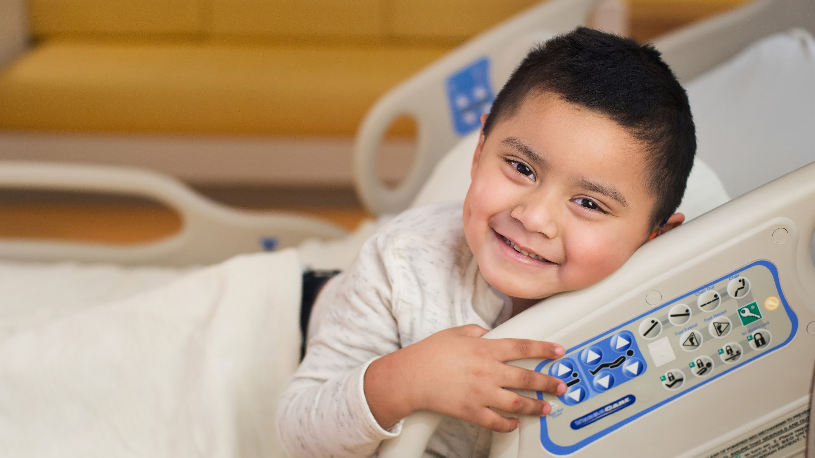
Why St. Jude?
Notes:
We are often asked the question “Why St. Jude?” – What makes St. Jude different from other hospitals? And why should I support St. Jude – a children’s hospital located in Memphis – when we have our own children’s hospital to support?
It’s a great question, and one that we are happy to answer. The first thing to understand is that we are not asking you to choose between St. Jude and other charities. We believe that local children’s hospitals are an essential part of every community. They deserve and need your support. Thankfully compassion does not have to be limited to just one cause.
So, let’s focus on what makes St. Jude different.

Slide 6
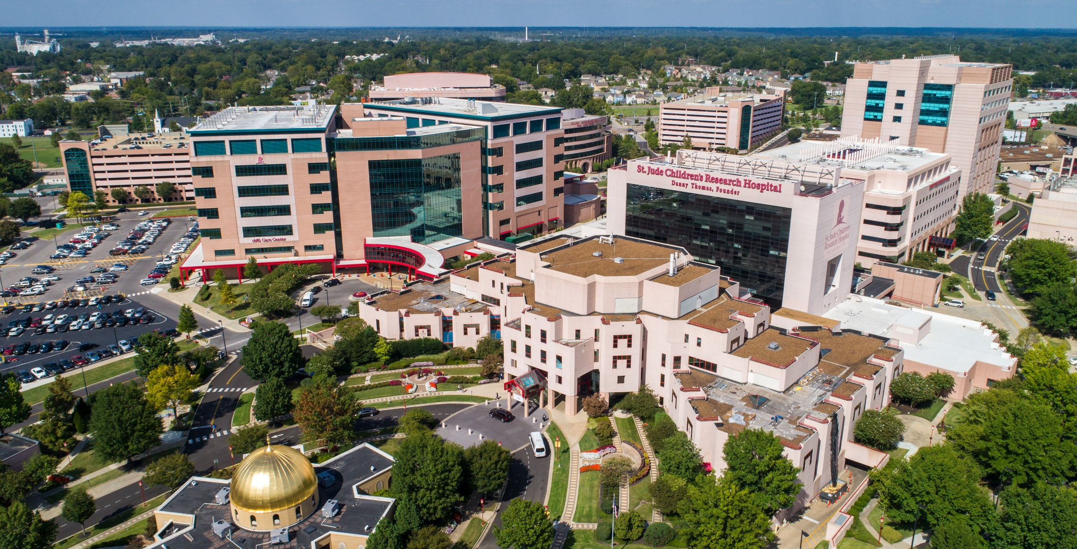
St. Jude is where doctors often send their toughest cases, because St. Jude has the world’s best survival rates for some of the most aggressive forms of childhood cancer.
Notes:
First, it is a research institution that is leading the way the world understands, treats and defeats childhood cancer, and other life-threatening diseases. Unlike a normal children’s hospital, St. Jude doesn’t have an emergency room, and we don’t treat broken bones or other pediatric conditions.
Our work in research and treatment is actually defining new and better ways for doctors everywhere to treat children with cancer. Doctors often send their patients to St. Jude when current treatments are not effective, or the resources are not available to treat their specific illness.
And when a doctor refers a patient to St. Jude, they stay in touch with the St. Jude care team to follow their patient’s progress, and provide ongoing consultations after they return home.

Slide 7
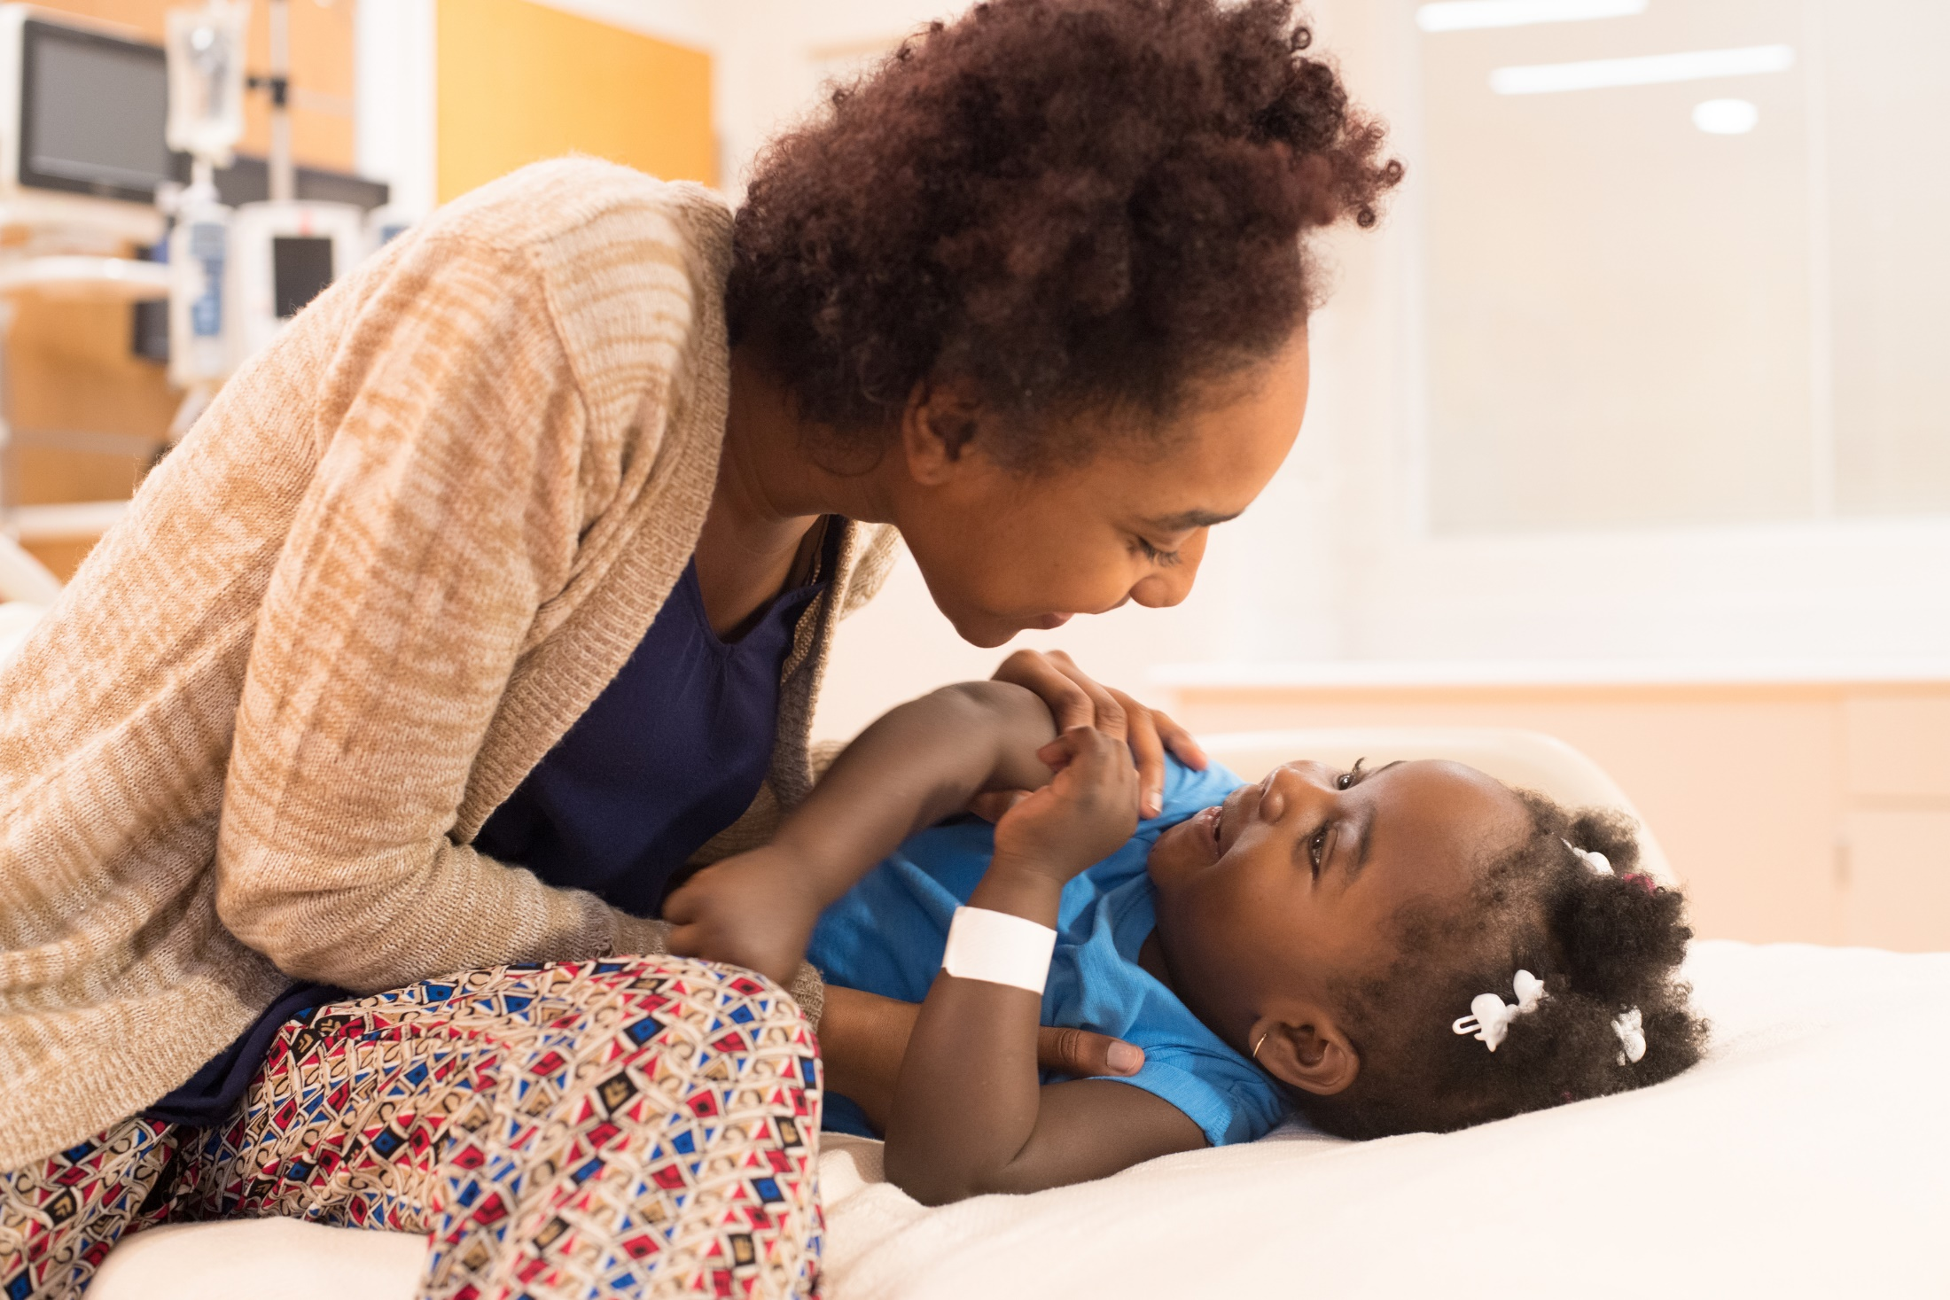
St. Jude freely shares the discoveries we make, and every child saved at St. Jude means doctors and scientists worldwide can use that knowledge to save thousands more children.
Notes:
We conduct more clinical trials for cancer than any other children’s hospital, turning laboratory discoveries into lifesaving treatments. And we collaborate with other hospitals and research institutions to expand access to our work, and to accelerate the rate of learning and discovery.
[FOR THOSE IN MARKETS WITH AFFILIATE CLINICS: This includes our St. Jude Affiliate Clinic program, a network of 8 children’s hospitals in the US who participate in St. Jude clinical trials for their local patients.
And because a majority of our research is funded by public contributions, we have the freedom to focus our efforts on the most promising research and treatments (not limited to what might be funded by available grants).
The specialized nature of our care takes us into uncharted territories. St. Jude has an on-site facility capable of manufacturing custom medications to support our constantly expanding understanding of cancer.
And, while cancer was once considered incurable, St. Jude now operates the largest cancer survivorship study in the US, providing long-term follow-up clinic for pediatric cancer patients in the United States, and we do this at no cost to the patients. The clinic helps patients stay healthy after active treatment ends and has been a prototype for other longer term follow-up programs. As yesterday’s patients grow into adulthood, we are learning more about how to minimize the side effects of treatments we deliver for children today.
And while St. Jude is leading the way in research, there is something else that sets us apart.

Slide 8
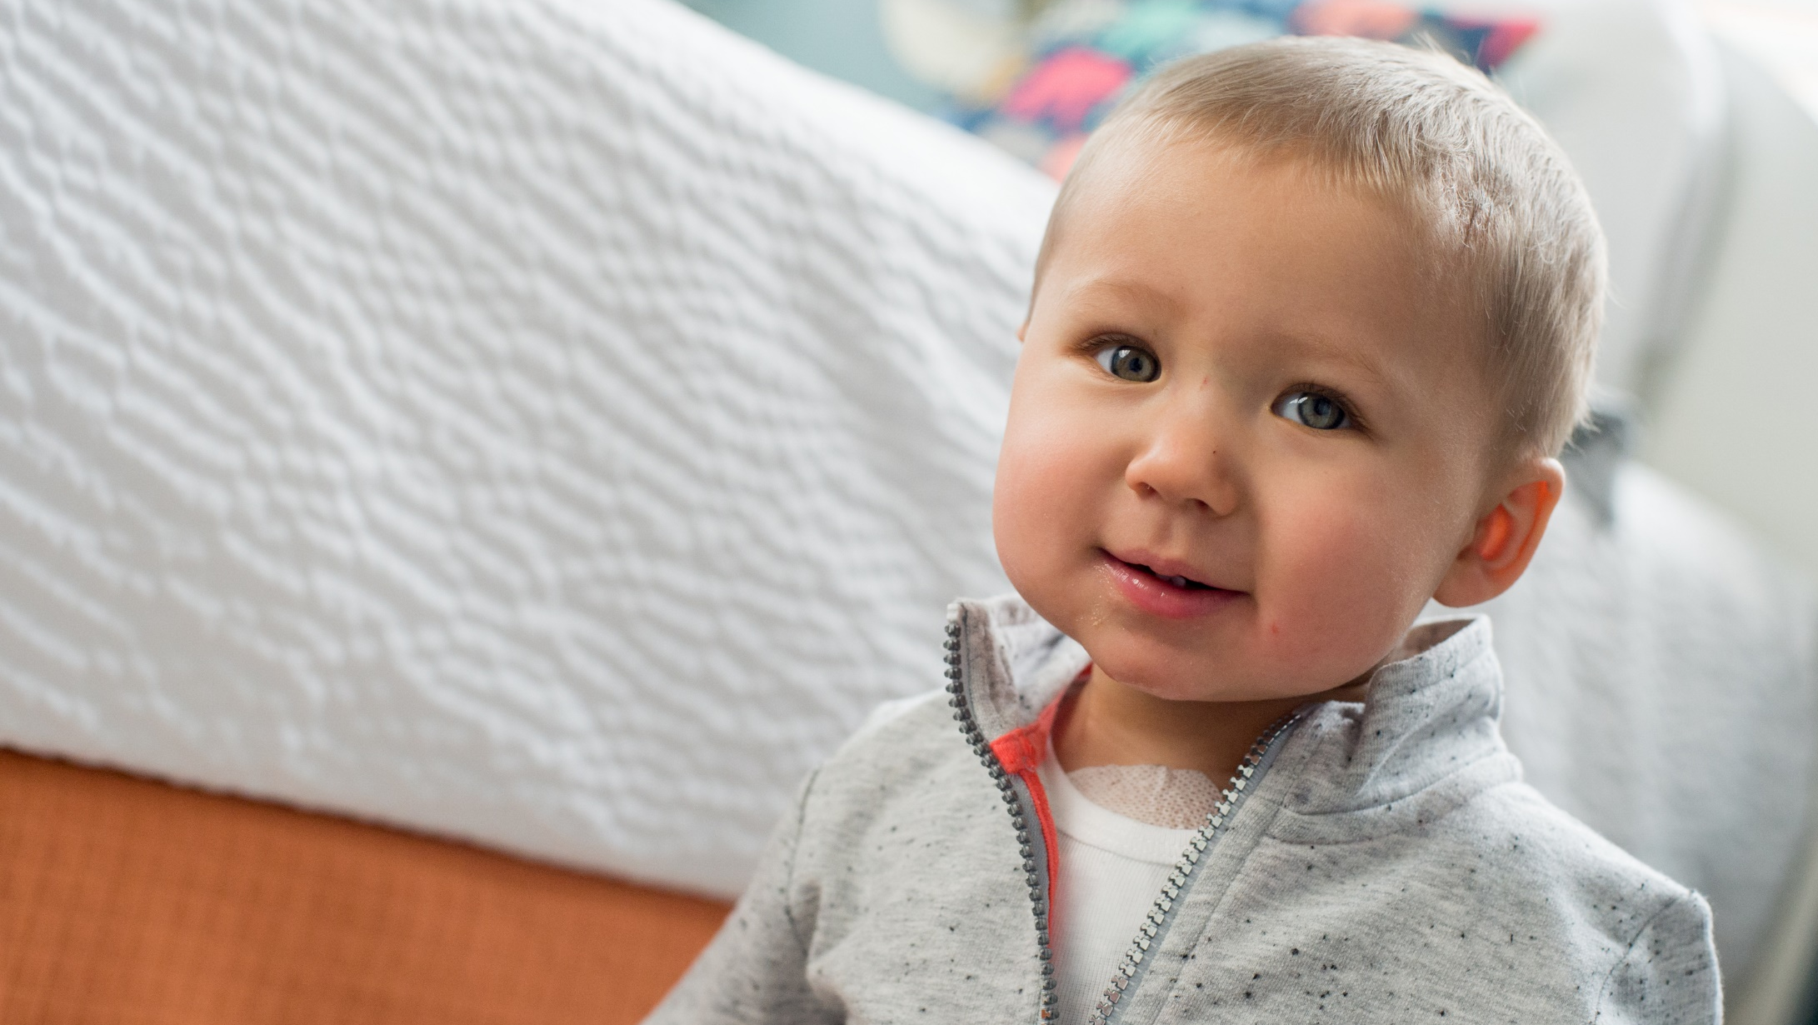
St. Jude conducts more clinical trials for cancer than any other children’s hospital, and turns laboratory discoveries into lifesaving treatments that benefit patients every day.
Notes:
Everything that St. Jude learns from these patients contributes to the world’s understanding about cancer and how to treat it more effectively.
St. Jude freely shares its discoveries, so that one child saved at St. Jude means doctors and scientists worldwide can use that knowledge to save thousands more children.
Whether they know it or not, patients are often treated at their local hospital using treatments that were informed by work done at St. Jude.
So in short, St. Jude is not competing with your local hospital; we are actually helping to improve the standard of care for children EVERYWHERE.
At St. Jude we are not only focused on finding cures, but also on improving the overall quality of life for our patients and are considered to be a leader in developing new treatments that minimize the side effects for all children treated for cancer.

Slide 9
Families never receive a bill from St. Jude for treatment, travel, housing or food – because all a family should worry about is helping their child live.
Notes:
Families never receive a bill from St. Jude - for treatment, travel, housing or food – because all a family should worry about is helping their child live.
At perhaps the most emotional time in their lives, St. Jude gives families the peace of mind knowing that they will never receive a bill for all the treatment and care that their child receives, now and for the future. And nobody else provides that level of unqualified support.
St. Jude can do this thanks to the incredible generosity of our donors – people just like you. Because of you, 75% of our costs are funded by contributions. This is vastly different than most other hospitals that generate 85% or more of their revenues through insurance recoveries and collections.

Slide 10
St. Jude treats children from all 50 states and around the world, including kids in your community
Notes:
At St. Jude, we treat children from all 50 states and around the world, including kids in your community, and our work helps improve the standard of care for children everywhere.
Your decision to support St. Jude makes you part of something much larger than any individual or community. You become part of a global movement to end childhood cancer.
Optional – use IF asked about International:
The St. Jude Global Pediatrics program is home to an innovative website called St. Jude Cure4Kids to give health care professionals everywhere a free and open online meeting place and educational resource.
Used by more than 32,000 health care professionals from 160 countries.
Content includes online seminars with audio narration, electronic full-text books and journals, online self-paced courses and interactive case discussions.
More than 120 international groups meet regularly on Cure4Kids.org.

Slide 11
St. Jude Brand Recognition
Notes:
Now that I’ve have shared the St. Jude mission and what makes us different, I’d like to discuss the benefits of partnering with us and aligning with our brand.

Slide 12
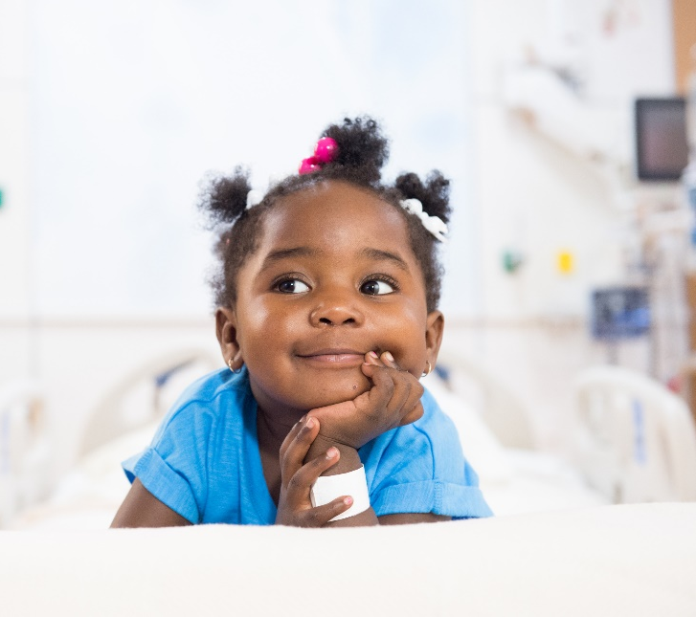
Brand Recognition
HEALTH NON-PROFIT
BRAND OF THE YEAR
6 YEARS IN A ROW
Named one of the
“100 BEST COMPANIES
TO WORK FOR”
for 9 consecutive years
NEARLY 9 OUT OF 10
RECOGNIZE THE ST. JUDE BRAND
#1 MOST
INSPIRATIONAL BRAND
WORLD VALUE INDEX
#1 BRAND IN
OVERALL QUALITY
IN THE HARRIS POLL
EQUITREND® STUDY
7 YEARS IN A ROW
OF OVER 45,000 CONSUMERS & MORE THAN 2,000 BRANDS
NAMED ONE OF THE
TOP 4 PLACES TO WORK
BY MILLENNIALS AND GEN Z
8 YEARS IN A ROW
HIGHEST
FAVORABILITY
OF ALL MAJOR
NONPROFITS
SOURCES: Harris Poll EquiTrend® Study; Enso World ValueSM Index; Independent Study; FORTUNE Magazine Poll; NSHSS Career Study
Notes:
The St. Jude brand remains one of the strongest brands in the non-profit world (4 out of 5 Americans recognize the St. Jude Brand) and the accolades listed on the screen help St. Jude doctors and scientists obtain the resources needed to save the lives of thousands of children, not only at the hospital in Memphis, Tennessee, but also at 24 official partner sites in 17 countries around the world.
For the 6th year in a row, St. Jude was named the #1 Health Non-profit Brand in the national Harris Poll EquiTrend study, a brand equity study that compares the brand health of more than 2,000+ unique brands across 200 categories. In addition, St. Jude received the highest quality ranking among ALL 2,000+ brands surveyed across 200 categories (including Google, Amazon, and Hershey) and was ranked the Most Trusted and Most Loved brand in the Health Non-profit space.
And St. Jude ranked in the top 10% of ALL brands for every metric in the study: familiarity, quality and consideration
Best Hospitals for Pediatric Cancer - Fifty pediatric centers were ranked in cancer. Five-year survival, bone marrow transplant services and infection prevention, along with other data collected from a detailed U.S. News clinical survey of children's hospitals, produced 85 percent of each hospital's score. The other 15 percent reflects nominations from pediatric specialists and subspecialists who responded to surveys in 2015, 2016 and 2017 and recommended the hospital for serious cases in their specialty.
St. Jude was also named one of the top places to work by Millennials for the past 7 years
(source: 2016 Millennial Career Survey (Independent Study) from the National Society of High School Scholars).
[TRANSITION]
So let’s take a deeper look at how the general population perceive us.

Slide 13
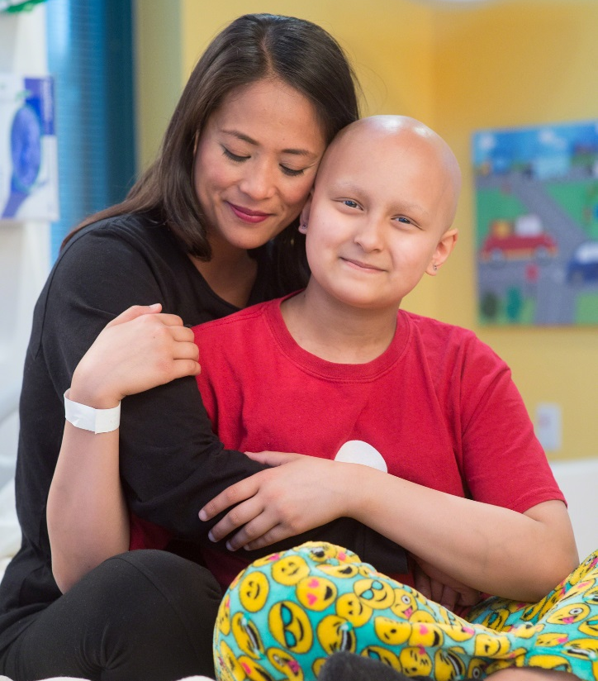
11 MILLION
ACTIVE DONORS
PARTNERSHIPS
WITH MORE THAN
100
MAJOR BRANDS
LARGEST
HEALTHCARE CHARITY
IN THE U.S.
75% OF DONATIONS
MOST LOVED HEALTH
NON-PROFIT
3 YEARS IN A ROW
COMES FROM THE
GENERAL PUBLIC
SOURCE: Harris Poll EquiTrend® Study

Slide 14
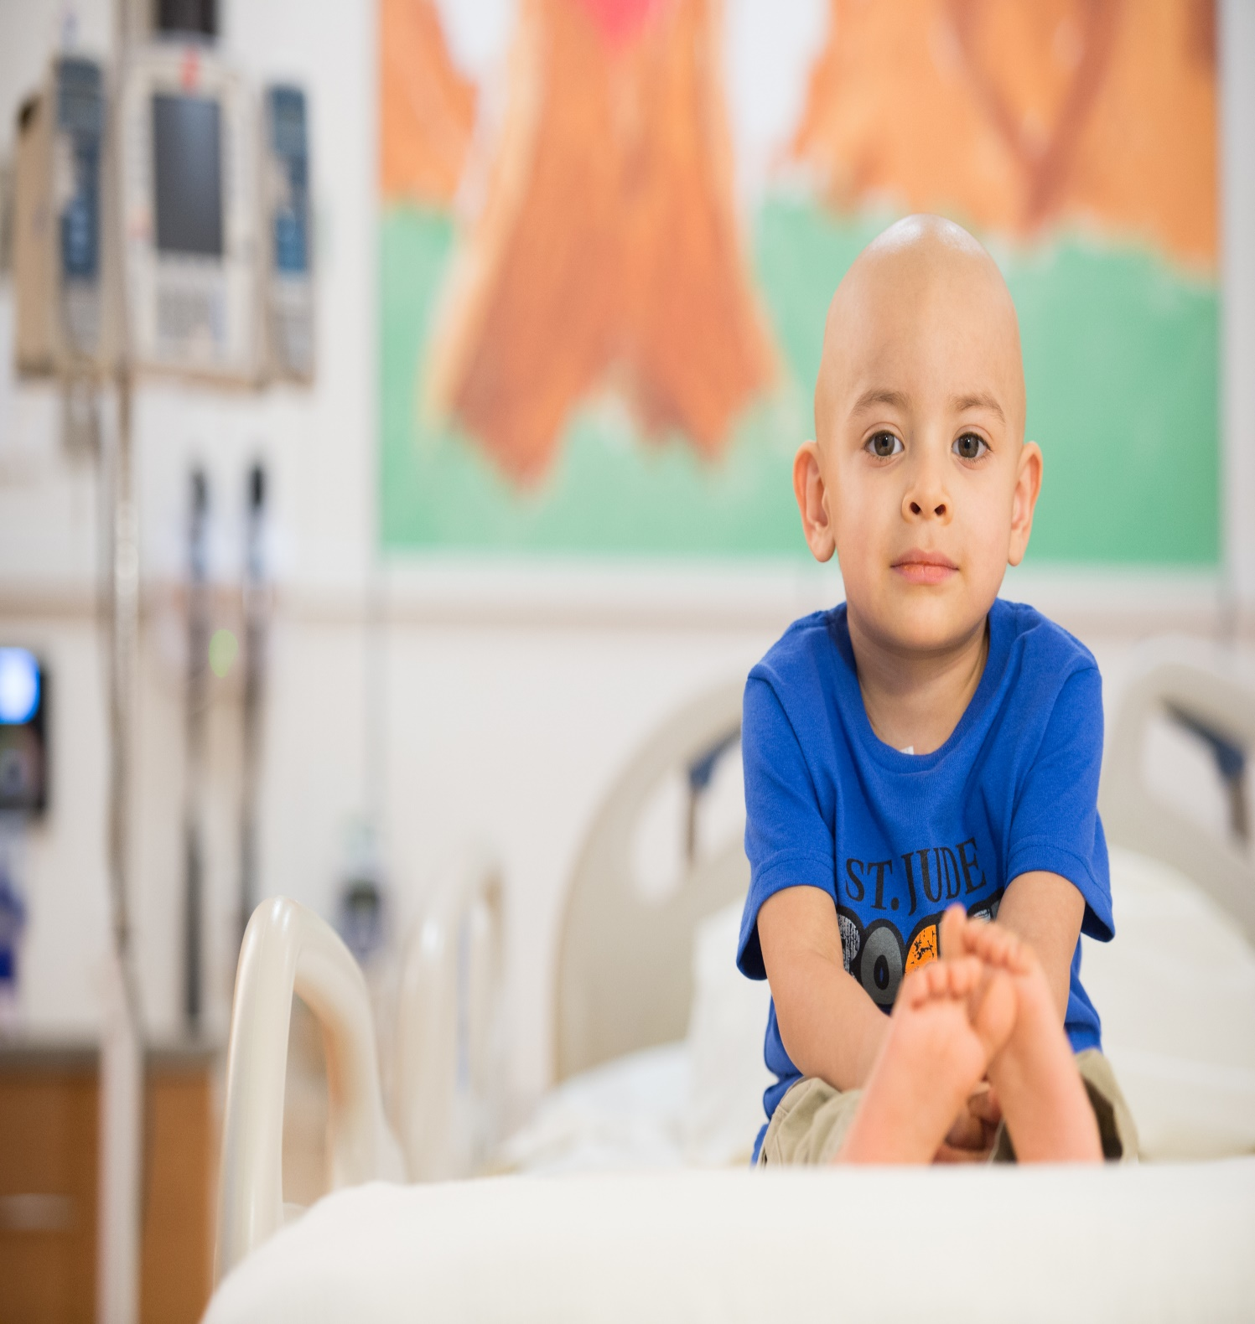
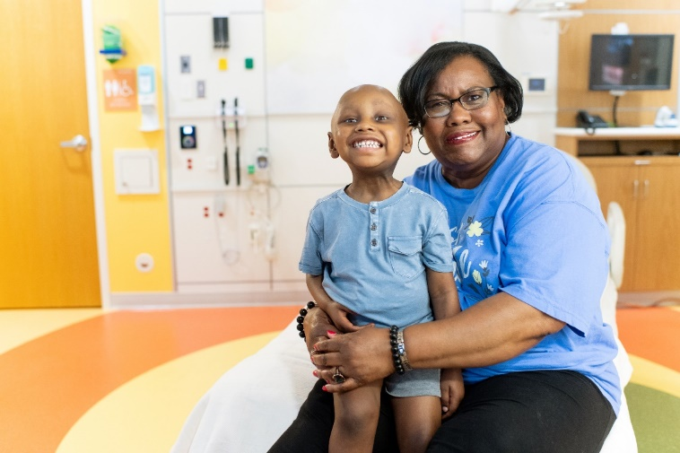
2.6 MILLION
MULTICULTURAL DONORS
72%
4 OUT OF 5
HISPANICS
RECOGNIZE THE
ST. JUDE BRAND
OF AFRICAN AMERICANS HAVE A FAVORABLE IMPRESSION OF ST. JUDE
7 OUT OF 10
ARAB AMERICANS
HAVE A FAVORABLE IMPRESSION
OF ST. JUDE
Notes:
More than 2.6 M of St. Jude donors reported multicultural backgrounds.
More than seven in ten African Americans and Arab Americans have a favorable impression of St. Jude
And 4 out of 5 Hispanics (English and Spanish speaking) recognize the St. Jude Brand

Slide 15
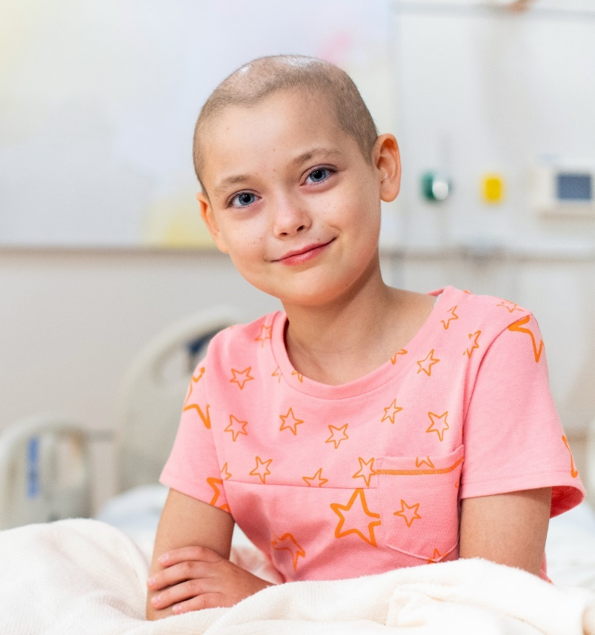
ST. JUDE DONORS ARE EXTREMELY LOYAL TO BRANDS WHICH SUPPORT CHARITY
UP TO 80% OF A BRAND’S CUSTOMERS HAVE A MORE FAVORABLE IMPRESSION OF THEM WHEN THEY LEARN THEY PARTNER WITH ST. JUDE.
ST. JUDE DONORS ARE UP TO
2X
MORE LIKELY TO SHOP THOSE BRANDS WHICH HAVE BEEN PARTICULARLY VOCAL IN THEIR SUPPORT OF A CAUSE.
Notes:
Additionally, we learned through research that:
St. Jude donors are loyal to brands supporting a cause. And they’ll even change their shopping habits to frequent companies who align with St. Jude.
(source: Edge Research Study)

Slide 16
OUR VISION FOR THE FUTURE
Reaching more children
Expanding the number of new cancer patients admitted by 20%
More than cancer
Increase focus on diseases such as sickle cell and other blood disorders
Survivorship
Double the number of participants in St. Jude LIFE program
Unlocking cancer’s mysteries
Genomes for kids
Notes:
We’ve made some great progress, but still have a long way to go.
And we have a bold plan for saving the lives of children worldwide who are battling cancer and other life-threatening diseases. Building on our tradition of collaboration and innovation established over the past five decades, St. Jude research and treatment have helped push the overall childhood cancer survival rate from 20 percent to more than 80 percent in the U.S. But as we said, 80% is not good enough.
Looking ahead, we are focused on achieving even more:
Reaching more children As part of an ambitious drive for the future, we want to double the number of children in St. Jude-led clinical trials. In addition, we will expand the number of new cancer patients admitted to St. Jude by 20 percent.
Beyond Cancer St. Jude has always conducted research on childhood diseases beyond cancer. In fact, our very first research grant was for the study of sickle cell disease. As part of our vision for the future, we will increase research that focuses on advancing research into cures for these diseases.
Survivorship St. Jude is a global leader in the research of childhood cancer survivorship through programs including St. Jude LIFE. This project brings St. Jude alumni back to campus to study the long-term effects of cancer and its treatment. More than 3,000 patients have enrolled in St. Jude LIFE, and we have set a goal to expand that number to 6,000 over the next six years. In addition, St. Jude will create a long-term follow-up study for patients with sickle cell disease with a goal to extend their lifespan and quality of life into adulthood.
Unlocking cancer’s mysteries In 2010, St. Jude collaborated with Washington University in an unprecedented research effort that resulted in sequencing the cancer and healthy genomes of more than 800 cancer patients to better understand why cancer occurs, spreads or resists treatment. St. Jude is taking that knowledge to patients with Genomes for Kids – a new clinical trial in which St. Jude cancer patients will have their healthy and cancer genomes sequenced to gain insight into their diseases.
But we can’t accomplish all of these ambitious goals without the continue commitment and support of millions of people who share the belief of our founder, Danny Thomas, that no child should die in the dawn of life.
OPTIONAL based on AUDIENCE:
Proton therapy - Include this IF you know you audience has STEM background or an interest in technology (General Population finds this too difficult to understand). St. Jude is the only pediatric cancer institution with a proton therapy center dedicated solely to children and began offering this innovative treatment to patients in 2015. This is important because proton therapy is an advanced form of radiation technology that delivers a more precise dose of radiation to the tumor. The treatment reduces harmful side effects because proton radiation does not expose surrounding tissue and organs – the radiation only goes as deep as necessary to reach the tumor
Clinical Research Consortium A vital piece of the long-term vision is the creation of a St. Jude-funded Clinical Research Consortium – a global consortium of about 12 institutions that will develop clinical trials for rare, aggressive diseases. Infantile leukemia is one example of a disease so rare that each institution might see only a couple of cases each year. But through the St. Jude Clinical Research Consortium, institutions could collaborate to gain scientific insights and make progress more quickly and efficiently.
For the children Every year, about 175,000 children worldwide are diagnosed with cancer. But more than 80 percent of these children live in low- and middle-income countries, where more than half will die from their disease. The St. Jude International Outreach Program (IOP) is dedicated to changing that statistic. The IOP already includes 24 partner sites in 17 countries, where results have been dramatic. But St. Jude recognizes more work remains to be done. St. Jude will enhance its efforts in the IOP in order to save the lives of more children around the world.

Slide 17
WHY ST. JUDE?
There are great…
Research Institutions
Charities
Children’s Hospitals
At St. Jude, we are all 3
Notes:
We know that there are many great hospitals, research institutions and charities in your community that also deserve and need your support. At St. Jude, we are all three. The innovative and collaborative work that we are doing at St. Jude is actually helping to improve the standard of care for children EVERYWHERE.
Our purpose is clear: Finding cures. Saving children.
We know what’s at stake, we’re in this together and we are not going to give up until we have a cure. Ask yourselves, IF NOT ST. JUDE, then WHO?
By supporting St. Jude, you are not supporting a single hospital in Memphis - you are supporting a movement to end childhood cancer.

